Slide 1

Traffic Control System using fuzzy logic
SRM Institute of Science and Technology
College of Engineering & Technology | School of Computing
Department of Computing Technologies
18CSC305J Artificial Intelligence – Mini Project
Team Members
RA2111030010267 Geethika
RA2111030010269 Sri Pavan Polisetti

Slide 2
Abstract
Traffic congestion is a pervasive issue in urban areas, particularly at intersections, where it disrupts the smooth flow of vehicles.
Traditional traffic light control systems often employ fixed timings, which are unable to adapt to the dynamic nature of traffic conditions.
This project proposes an innovative solution: an adaptive traffic light controller utilizing fuzzy logic, specifically the Sugeno method.
The system's main objective is to calculate optimal green light durations based on real-time traffic density data at intersections.
By considering factors such as regulated lane density and opposing lane densities, the system can make dynamic adjustments to traffic signal timings.
Through the application of fuzzy logic, the system aims to optimize traffic flow and alleviate congestion by aligning green light durations with the current traffic conditions.

Slide 3
Introduction
Background:
Urban areas worldwide face significant challenges related to traffic congestion, which not only lead to increased travel times and fuel consumption but also contribute to environmental pollution and reduced quality of life.
Intersections serve as critical points where traffic congestion accumulates due to the convergence of multiple traffic streams.
Conventional traffic light controllers operate on fixed timing schedules, lacking adaptability to changing traffic conditions.
Significance of the Project:
The development of an adaptive traffic light controller using fuzzy logic presents an opportunity to address the shortcomings of traditional traffic management systems.
By dynamically adjusting signal timings based on real-time traffic data, the proposed system has the potential to significantly improve intersection efficiency and reduce congestion.
Utilizing fuzzy logic allows for the incorporation of human-like reasoning and decision-making, making the system more robust and adaptable to varying traffic conditions.

Slide 4
Challenges / Motivation
Traffic congestion poses multifaceted challenges to urban environments, including increased travel times, reduced productivity, and negative environmental impacts such as air pollution and greenhouse gas emissions.
Traditional traffic light control systems often fail to address these challenges effectively, as they rely on fixed schedules or rudimentary algorithms that do not account for real-time traffic dynamics.
The motivation for this project stems from the pressing need to develop more sophisticated and adaptive traffic control solutions capable of responding dynamically to changing traffic conditions.
By leveraging advanced techniques such as fuzzy logic, the project aims to overcome the limitations of traditional traffic light control systems and contribute to the development of more efficient and sustainable urban transportation networks.

Slide 5
Problem Statement
The primary objective of the project is to design and implement an adaptive traffic light controller using fuzzy logic, specifically employing the Sugeno method.
The system aims to calculate green light durations at intersections based on real-time traffic density data, taking into account variables such as regulated lane density, opposing lane densities, pedestrian crossings, and emergency vehicle presence.
The key challenge lies in developing a robust fuzzy logic-based algorithm capable of dynamically adjusting green light durations to optimize traffic flow and reduce congestion while ensuring safe and efficient movement of vehicles, pedestrians, and other road users.
By addressing this problem, the project seeks to contribute to the advancement of traffic management strategies aimed at improving urban mobility, reducing congestion, and enhancing overall quality of life in urban environments.

Slide 6
Literature Survey
Traffic Congestion and Management:
Review of existing literature on the challenges posed by traffic congestion in urban areas and the various approaches employed for traffic management.
Discussion on the limitations of traditional fixed-timing traffic light control systems and the need for adaptive solutions.
Fuzzy Logic Applications in Traffic Control:
Exploration of previous research and implementations utilizing fuzzy logic for traffic light control.
Analysis of the advantages of fuzzy logic in handling uncertain and dynamic traffic conditions compared to traditional methods.
Sugeno Method in Fuzzy Logic Control:
Overview of the Sugeno method and its application in fuzzy logic control systems.
Examination of the suitability of the Sugeno method for adaptive traffic light control and its advantages over other fuzzy logic techniques.

Slide 7
Existing System / Work
Traditional Traffic Light Control Systems:
Description of conventional fixed-timing traffic light control systems and their operation.
Evaluation of the limitations of fixed-timing systems in addressing dynamic traffic conditions and reducing congestion.
Previous Adaptive Traffic Control Systems:
Overview of existing adaptive traffic control systems that utilize different approaches such as machine learning, optimization algorithms, and fuzzy logic.
Analysis of the strengths and weaknesses of previous adaptive systems in managing traffic congestion.

Slide 8
Proposed System / Work
Overview of Adaptive Traffic Light Controller:
Description of the proposed system for adaptive traffic light control using fuzzy logic, specifically the Sugeno method.
Explanation of how the system aims to dynamically adjust signal timings based on real-time traffic data to optimize traffic flow.
System Components and Features:
Detailed explanation of the components of the adaptive traffic light controller, including data collection mechanisms, preprocessing modules, fuzzy logic controller, and rule base.
Workflow and Operation:
Step-by-step explanation of how the proposed system operates, from data collection to signal timing adjustments.
Discussion on how the fuzzy logic controller processes input data and generates control actions for traffic lights.

Slide 9
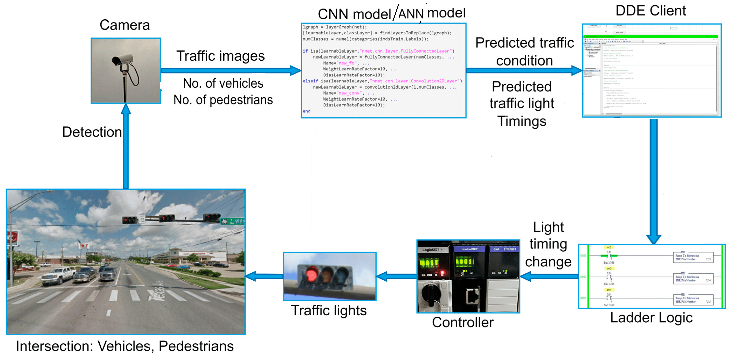
Architecture / Data Flow Diagram

Slide 10
Data Collection and Preprocessing:
Traffic data is captured by cameras placed near traffic lights.
The captured data, including images of traffic conditions and counts of vehicles and pedestrians, is processed by a Convolutional Neural Network (CNN) and an Artificial Neural Network (ANN) model.
The CNN model analyzes images to extract information about traffic density, while the ANN model processes numerical data such as vehicle and pedestrian counts.
Predicted traffic conditions and estimated traffic light timings are generated as reports based on the output of the CNN and ANN models.
Data Transmission to DDE Client:
The generated reports from step 1 are transmitted to a Data Distribution and Exchange (DDE) client.
The DDE client acts as a database server, collecting data from multiple sources at different intersections.

Slide 11
Traffic Light Control Logic:
Data received by the DDE client is then forwarded to the ladder logic system.
The ladder logic system processes the incoming data to determine optimal timing adjustments for traffic lights at each intersection.
Based on the predicted traffic conditions and historical data, the ladder logic system generates instructions for adjusting the timing of traffic lights to improve traffic flow.
Implementation and Display:
The instructions generated by the ladder logic system are sent to the traffic light controllers.
The traffic light controllers adjust the timing of traffic lights based on the received instructions.
Results of the timing adjustments are displayed on the traffic light signal boards at the respective intersections.
Additionally, resulting reports based on the collected data, traffic conditions, and implemented timing adjustments are generated and made available for analysis and further optimization.

Slide 12
Prototype / Application Developed
Phase 1 – Work Flow & Algorithm Used:
Introduction to Prototype Development:
Brief overview of the traffic control prototype developed.
Emphasis on the utilization of advanced technologies for adaptive traffic management.
Work Flow Overview:
Diagram illustrating the flow of data from traffic cameras to the traffic light controllers.
Explanation of each step, including data collection, preprocessing, algorithmic processing, and signal adjustment.
Algorithm Used: CNN and ANN Integration:
Description of the Convolutional Neural Network (CNN) and Artificial Neural Network (ANN) models employed.
Explanation of how CNN processes image data while ANN handles numerical inputs.

Slide 13
CNN Model for Image Processing:
The CNN architecture consists of multiple convolutional and pooling layers followed by fully connected layers.
It learns spatial patterns and features from traffic images, enabling it to predict traffic conditions such as congestion and vehicle density.
The CNN model undergoes training using labeled data to optimize its performance in predicting traffic states accurately.
ANN Model for Numerical Data:
The ANN architecture comprises input, hidden, and output layers, with neurons interconnected through weighted connections.
It processes numerical data obtained from sensors and other sources to estimate traffic parameters such as vehicle counts and pedestrian volumes.
Training of the ANN model involves adjusting weights and biases to minimize prediction errors and improve accuracy.
Integration and Report Generation:
Predictions from both the CNN and ANN models are integrated to generate a comprehensive report on current traffic conditions.
The report includes insights into traffic density, congestion levels, and recommended adjustments to traffic light timings for optimizing traffic flow.

Slide 14
Prototype Development Challenges:
Challenges encountered during prototype development include data preprocessing complexities, model training and optimization, and integration of predictions.
Overcoming these challenges required iterative refinement of algorithms, extensive testing, and collaboration between interdisciplinary teams.
Future Work:
Future enhancements may include incorporating additional data sources such as weather conditions and road infrastructure status for more accurate predictions.
Improvements in model performance, scalability, and real-time responsiveness will be prioritized to enhance the effectiveness of the traffic control prototype.

Slide 15
Phase 2 – Evaluation Metrics & Performance Analysis:
Evaluation Metrics:
Description of key metrics used to evaluate the performance of the prototype.
Metrics may include average vehicle delay, queue lengths, and intersection throughput.
Performance Analysis:
Presentation of results obtained from testing and simulation.
Comparison of prototype performance against traditional fixed-timing systems.

Slide 16
Phase 3 – Results & Discussion:
Traffic Control Effectiveness:
Discussion on how the adaptive traffic control system improved traffic flow and reduced congestion.
Presentation of data indicating the impact of the prototype on intersection efficiency.
Real-world Implementation Insights:
Reflections on the feasibility and practicality of implementing the prototype in real-world scenarios.
Identification of potential challenges and considerations for deployment.
User Feedback and Acceptance
Summary of feedback received from users and stakeholders during testing.
Discussion on user acceptance and satisfaction with the prototype's performance.

Slide 17
Phase 4 – Conclusion & Future Enhancement:
Conclusion:
Recap of the key achievements and outcomes of the prototype development.
Affirmation of the effectiveness of the adaptive traffic control system in improving intersection efficiency.
Future Enhancement:
Mention of future directions for enhancing the prototype.
Discussion on potential areas for further research and development to refine the system's capabilities.

Slide 18
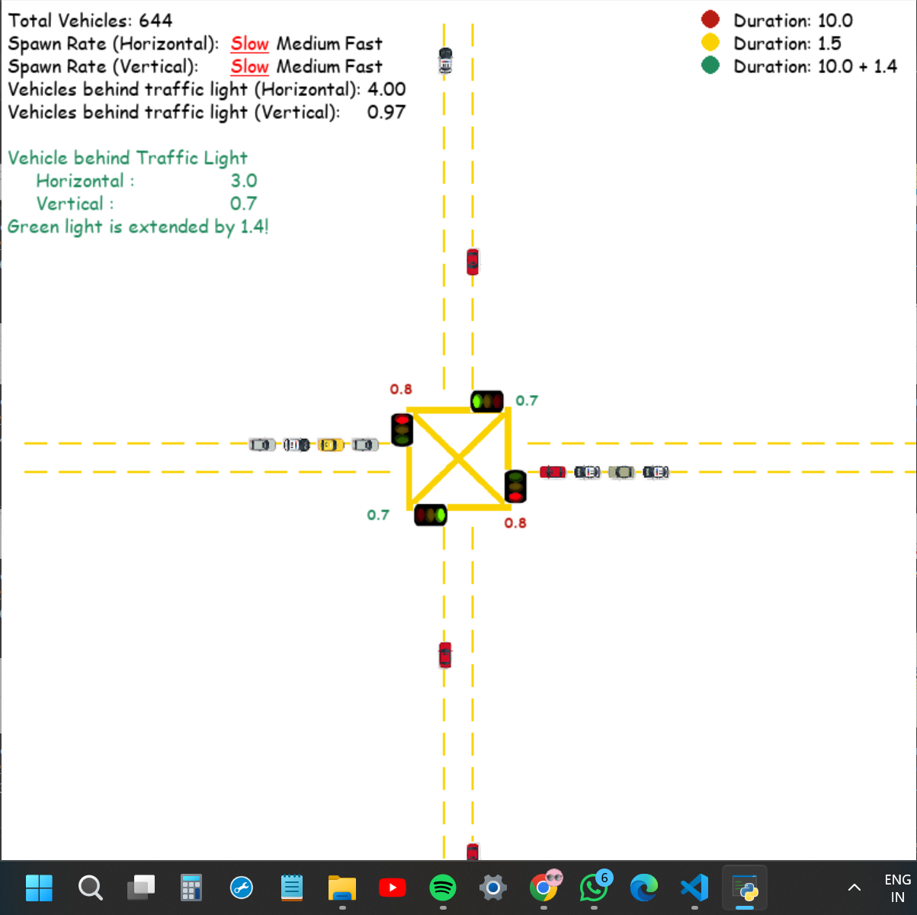

Slide 19
References
Zhang, Jianming, and Huimin Zhao. "Traffic signal control system based on fuzzy logic." IEEE International Conference on Automation and Logistics. IEEE, 2008.
This paper presents a traffic signal control system utilizing fuzzy logic to adaptively adjust signal timings based on real-time traffic conditions.
Feng, Jian, and Xiaohong Jiang. "Fuzzy logic based intelligent traffic signal controller." 2010 International Conference on Intelligent Control and Information Processing. IEEE, 2010.
The authors propose an intelligent traffic signal controller using fuzzy logic to optimize traffic flow and reduce congestion at intersections.
Liu, Ming, et al. "Traffic signal control system based on adaptive fuzzy logic." 2015 IEEE International Conference on Cyber Technology in Automation, Control, and Intelligent Systems (CYBER). IEEE, 2015.
This paper presents a traffic signal control system that dynamically adjusts signal timings using adaptive fuzzy logic to improve intersection efficiency.
Ramezani, Mohammad, and Mohammad Javad Barmshoori. "Fuzzy logic-based urban traffic signal control system." 2016 IEEE International Conference on Power, Control, Signals and Instrumentation Engineering (ICPCSI). IEEE, 2016.
The authors propose a fuzzy logic-based urban traffic signal control system aimed at reducing traffic congestion and improving traffic flow in urban areas.

